Slide 1

ICT
Information and Communication Technologies

Slide 2

Plan
Introduction
Google services
Microsoft tools
Git and Github
Integration of technologies
Challenges and solutions
Future trends in ICT technologies
Conclusion

Slide 3
1.
Introduction

Slide 4
Information and communication technologies (ICT) are the core of modern technological landscapes, shaping the way we communicate, collaborate and innovate. This report delves into the specifics of key ICT technologies, focusing on Google services, Microsoft tools, Git and Github

Slide 5
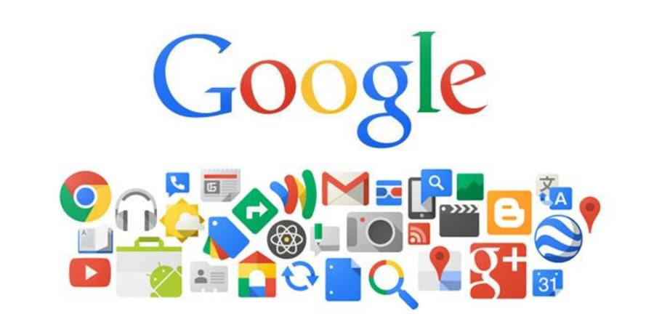
2.
Google services

Slide 6
a. Overview:
google services constitue a comprehensive suite of tools and applications designed to enhace productivity, collaboration and communication
b. Key components
Google services | Description
Gmail | Email and communication platform
Google Drive | Cloud storage and file sharing
Google workspace | Productivity suite including docs and sheets
Google meet | Video conferencing and collaboration tool

Slide 7
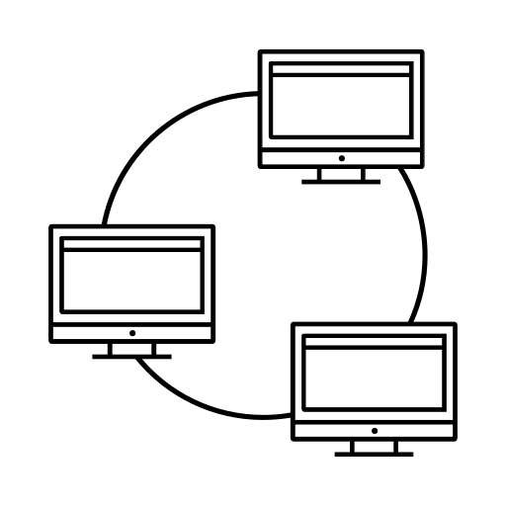

c. Impact on ICT
They have impacted ICT by providing cloud-based solutions thst facilitate seamless collaboration and information sharing

Slide 8
3. Microsoft tools

Slide 9
a. Overview:
Microsoft offers a diverse range of tools and applications catering to various aspects of information management, productivity and collaboration
b. Key components:
Microsoft tools | Description
Microsoft 365 | Cloud-based suite including word and Excel
Microsoft teams | Collaboration platform with chat and video
Azure DevOps | Tools for software development and collaboration
Share Point | Content management and collaboration platform

Slide 10



c. Impact on ICT:
Microsoft tools has been instrumental in transforming ICT by providing a unified ecosystem for seamless collaboration and development

Slide 11
4.
Git and GitHub

Slide 12
a. Overview:
Git and GitHub are fundamental tools in software development, enabling version control and collaboration coding practices
b. Key components:
Git features | Description
Version control | Tracking changes in code over time
Branching and merging | Parallel development and code integration
GitHub repositories | Cloud-based storage and collaboration platform

Slide 13



c. Impact on ICT:
Git and GitHub revolutionized software development by introducing efficient version control and collaborative coding practices

Slide 14

5.
Integration of Technologies

Slide 15



a. Collaborative use:
Explore how these technologies can be integrated for seamless collaboration, with real-world case studies.
b. Interoperability:
The advantages of using all the technologies explained before together

Slide 16



c. Case studies:
Present case studies demonstrating successful integration of these technologies in diverse scenarios

Slide 17

6.
Challenges and solutions

Slide 18




a. Common challenges:
Identify common challenges associated with the use of these technologies in ICT
b. Solution and best practices:
Provide solutions and best practices to overcome challenges, drawing from industry experiences

Slide 19


c. Case studies:
Present case studies illustrating how organizations have addressed and overcome challenges in implementing these technologies

Slide 20
7.
Future trends in ICT technologies

Slide 21



a. Innovation in Google services:
Explore upcoming innovations and features in google services that are likely to shape the future of ITC
b. Microsoft’s technological roadmap:
Examine Microsoft’s roadmap, highlighting emerging tech and their implication for the ICT landscape
c. Advancements in Git and GitHub:
Discuss features that could influence the future of collaborative software dev

Slide 22

8. conclusion

Slide 23






a. Summary of key findings:
b. Implications of the future
c. Recommendations
Provide recommendations for organizations looking to leverage these tech for enhanced collaboration and productivity

